Slide 1
Process Mapping
U4 – Measure
E1 – Process Mapping & Data Collection
The element ‘Process Mapping & Data Collection’ sets out the different ways of process mapping to visualize the process. This element also covers types of data and the accuracy and integrity of data.
Yellow Belt
Notes:
Welcome to this Lean Six Sigma Academy Yellow Belt training module.

Slide 2
Process Mapping
Process-thinking
Process: systematic series of activities required to achieve a goal
To find and reduce waste in your processes the following is important:
  Know what your processes are
  Know how your processes flow through your organisation
    Tool: process mapping
Notes:
A Process Flow chart schematically illustrates the different process steps. It uses standard symbols for the activities and the decision points within a process. Arrows are used to indicate the direction of the flow. There is also a separate symbol for the start and end point, both of which should be clearly defined.

Slide 3
Process Mapping
Why is process-thinking important?
  To understand how all the work is done (and in which order)
  To understand interdependencies
  To get a clear view of what is actually happening in the organisation
  Blame the process, not the people
Notes:
Process thinking is important for understanding of how work is done and how work is connected in an organisation

Slide 4
Process Mapping
Disadvantage of thinking in departments
  Throwing work (work in progress: WIP) over the fence
WIP
Notes:
The disadvantage of thinking within your area or department is that is gives you an “island” mentality and you don’t recognise what is happening outside of your area and how it affects the overall process or customer

Slide 5
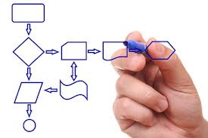
Process Mapping
Why should you make a process map?
  To communicate the processes
  To define the scope of a project
  To describe and understand the processes
  To document and standardise the processes (ISO 9000)
  To define responsibilities and competencies
  To analyse the processes / problems
  To identify improvement opportunities
Notes:
Process Mapping has many uses –its explains the process visually, helps communicate and define the process. It is also an important tool for documentationn and standardisation of the process to help identify opoortunities for improvement.

Slide 6
Process Mapping
Process flow or flowchart
  Schematic representation of the current/ suggested process flow
  Overview of activities and decision points
  Has a clear beginning (start) and end (stop)
Process map symbols (examples)
Start
Step 1
Step 2
Step A
Activity
Should start with a verb
?
No
Step 5
Decide
Decision Point
At least two paths emerge from a decision point. Usually: Yes and No
Yes
Step 3
Step 6
Direction
Shows connection and direction of flow
Step 4
Start
Start / End
Start or end of a process
Stop
Notes:
A Process Flow chart schematically illustrates the different process steps. It uses standard symbols for the activities and the decision points within a process. Arrows are used to indicate the direction of the flow. There is also a separate symbol for the start and end point, both of which should be clearly defined.

Slide 7
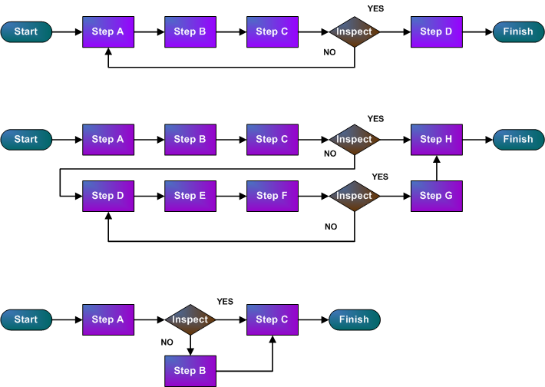
Process Mapping
Three interpretations of a process
  The process as you THINK it is:
  The process as it ACTUALLY is:
  The process as it SHOULD be:
Notes:
There are 3 ways you can interpret a process; the process you think it is (few steps), the process as it actually is (several more steps) or the process as it should be (the least steps).

Slide 8
Process Mapping
Example creating a flowchart: visiting outpatient clinic
Identify the borders of the process
  Start: patient checks in
  End : patient leaves
Describe the primary purpose and activities
  Operational definition
Process Activities
  Patient at check in desk → Secretary enters patient into system → Secretary takes chart to nurse → Patient taken to room → Visits taken → Chart to doctor → Doctor reviews chart → Doctor sees patient → Consult with attendant physician → Doctor revisits patient → Patient to check out → Patient leaves clinic
Notes:
Visiting an outpatient clinic is a good example of creating a process flow……..there are over 12 steps in this potentially simple task.

Slide 9

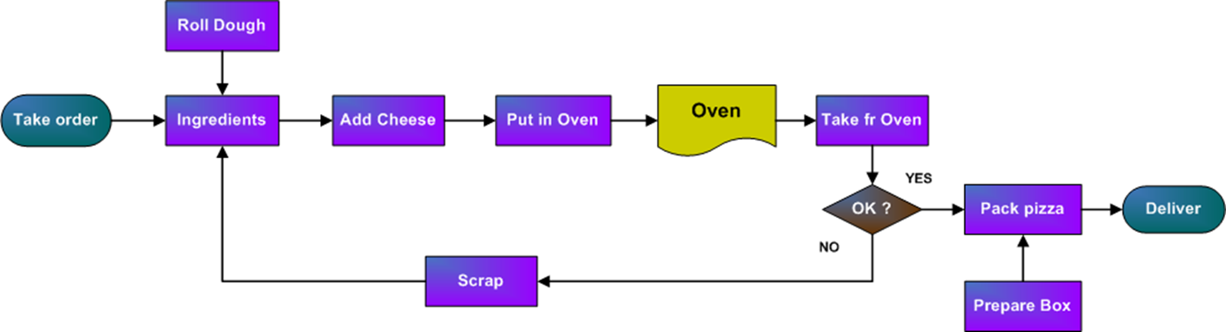
Process Mapping
First, create a global process map of main activities
  When a ‘higher level’ process map is established, a more detailed map can then be created from the area we want to focus on.
  Select the area that represents the problem & create a detailed process map of this area
Notes:
When process mapping it is important to create a high level flow of activities this can then be broken down and the area of concern analysed

Slide 10
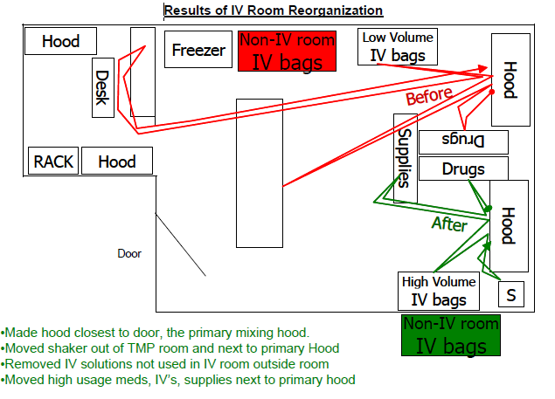
Process Mapping
Spaghetti diagram
Re-organisation of laboratory based on mapping of motion within the lab:
Notes:
A spaghetti diagram is made by observing actual movements. These movements could be those of operators or parts on the shop floor or of papers in the office. Each movement is recorded as a separate line; the resulting diagram therefore shows how often a movement occurs. It is also important to note why the movement was made. The spaghetti diagram is a great tool that can be used to identify potential improvements in the layout of an administration area or an office or a lab.

Slide 11
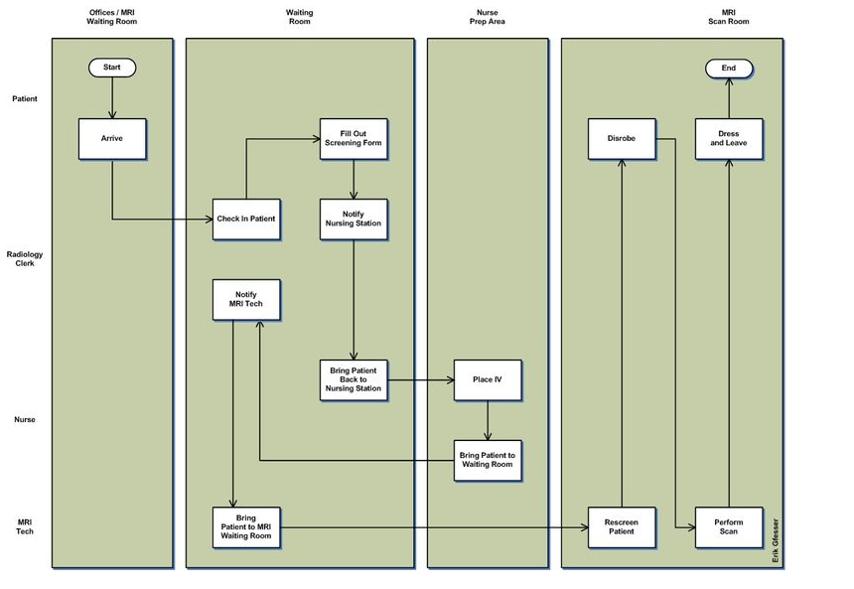
Process Mapping
Swimlane – Patient MRI
Notes:
A high level process map called a “swimlane” is shown here. For example a swimlane of a patient MRI shows the different areas or processes that a patient goes through when receiving an MRI.

Slide 12
VSM – Value Stream Mapping
U5 – Analyse
E3 – Analytical Methods
The element ‘Analytical Methods’ describes the tools that can be used for risk analysis, root cause analysis and waste identification.
Yellow Belt
Notes:
Welcome to the Value Stream Mapping module

Slide 13

VSM Current State
What is ‘Value’?
  If we want to use the concept ‘Waste’, we first need to understand ‘Value’
  Not all activities in your process contribute to ‘Value’
Value
The activities that customers are
willing to pay for
123RF Stock Photo
Notes:
Value is defined as: an activity for which the customer is willing to pay. This means that trying to add value to a product through an activity within the organization is only important if it is in the interest of the customer. The customer must see the activity as being value adding and be willing to pay for performing this activity.

Slide 14
VSM Current State
Types of activities
  Every activity in your process can be classified as:
  Value adding activity Customer wants to pay for this
  It must be done right first time
  The activity must change the product or service
  Non-Value adding activity Customer doesn’t want to pay for this
  Enabling activity Necessary for the process
Notes:
These activities can be classified into three different categories: value adding activities (or VA for short), non-value adding activities (or NVA for short) and necessary activities, also called enabling activities. What can be observed in many companies, is that only a very small proportion of all activities add value to the product. By creating a value stream map of a company, we can differentiate between all of these value adding and non-value adding activities.

Slide 15
VSM Current State
Value stream mapping is a management tool
  Many improvement activities simply focus on single processes, rather than accounting for possible connections with other processes
  By making a ‘door-to-door’ value stream, you can examine the bigger picture and account for the connections between all processes
Partners/ suppliers
Your organisation
Customer/ patient
Adding Value
Notes:
With this information, we can now start to create a value stream map. The total value stream of a company consists of all the activities that are necessary to create the product or deliver the service. To begin with value stream mapping, we normally start with our most important product or product group. In general, we start from receiving the raw materials and end with delivery of the product to the customer, the door-to-door concept. A value stream map can also be made for the service industry.

Slide 16
VSM Current State
Construction of a current state map
  Start with a walk along the whole ‘door-to-door’ value stream
  Begin at the end of the value stream and move up the stream
  Use a stopwatch: don’t look at standard times, determine the actual times
  Bring the entire value stream map together: draw the value stream map
  Collect current state information by following existing roads of information and documents flows
Notes:
To construct a current state map –one should walk the process from “door to door”. Determine actual times taken to perform steps. Finally draw the value stream map.

Slide 17
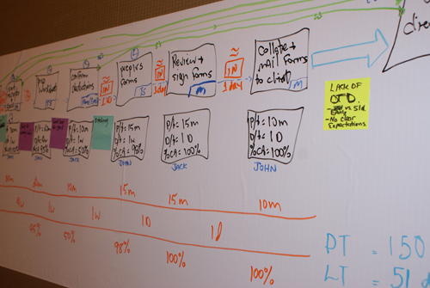
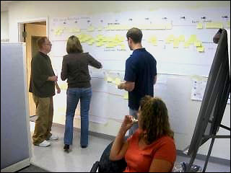
VSM Current State
Construction of a current state map
Notes:
Visually you can add information and data to the map. You can also draw arrows to demonstrate interactions and flows of information.

Slide 18
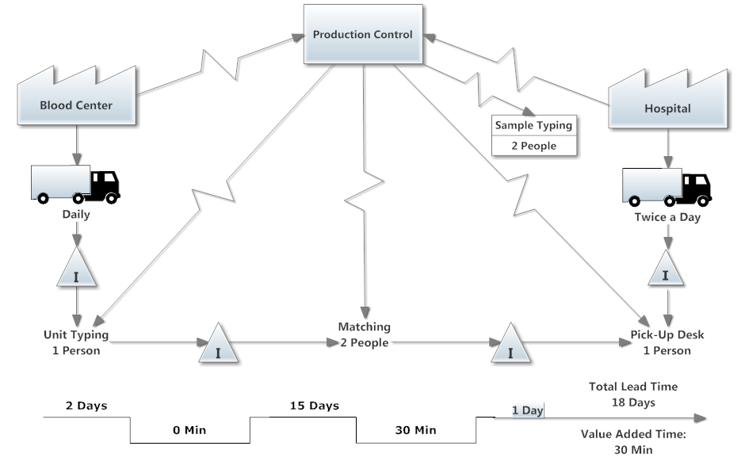
VSM Current State
Example 1 current state
Notes:
Here we can see an example of a current value stream map for a blood supply to a hospital. In this case, products are delivered to the customer (hospital) on a daily basis. If we look at the value adding activities, we see that they only take 30 minutes. But the total time to deliver the product to the customer takes 18 days. A lot of time is lost waiting and on processing between steps as well as in inventory.

Slide 19
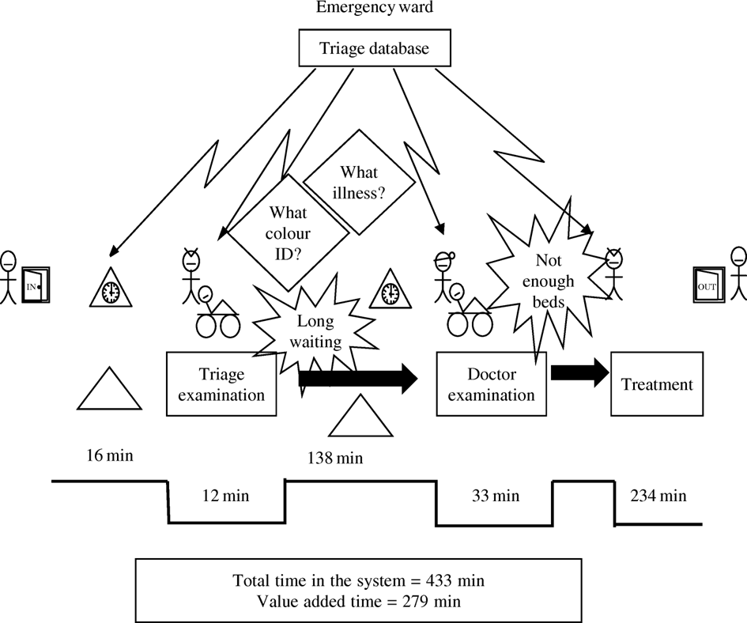
VSM Current State
Example 2 current state
Notes:
This VSM looks at an emergency department process. The entire processing time for a patient is over 400 minutes. There are a lot of wastes identified within the map –waiting times, transport, overprocessing etc
The value add times are minimal.

Slide 20
VSM Current State
Value adding time %
Value adding time % = value added time/ lead time * 100%
In example 1:
Value adding time: 12 min + 33 min + 234 min = 279 min
Lead time: 16 min + 12 min + 138 + 33 min + 234 min = 433 min
Value adding time %
= 279/ 433 * 100%
= 64%
Notes:
To work out the value added time in the first example: add 12 min plus 33 plus 234 min to give 279 mins.
The Lead time is 16 +12+138+33+234 = 433 min.
The Value adding time % is 279/433 = 64%.
This means 36% of the process is waste or non value added time

Slide 21
VSM Current State
Value adding time %
In example 2:
Value adding time: = 30 min
Lead time: 2 days + 15 days + 30 min + 1 day = 18 days
Value adding time %
= 18 * 24 * 60/ 30 * 100%
= 0,12%
Notes:
From example 2:
The Vale added time is 30 mins.
The lead time is 2 days plus 15 days plus 30 min plus 1 day =18 days
The Vale adding time % is 18*24*0/30*100% =0.12%

Slide 22
VSM Future State
Construction of a future state map
  Use the customer needs as a starting point, including quality demands and lead time
  Implement flow to get the right quality and quantity at the correct time at the customer
  Spread the work evenly, in order to reduce waiting time and use smaller work units
  At the end of these steps an important part of the waste in the process will be reduced or removed!
Notes:
If we made a future state value stream map of the blood supply process -the company would still deliver on a daily basis to the company, but from a structured inventory or Kanban. The actual value added activities would be increased with a significant reduction of waiting time and intermediate inventories would be achieved. Of course we can only realize these improvements by executing a large number of projects. This can be done using Kaizen events.

Slide 23
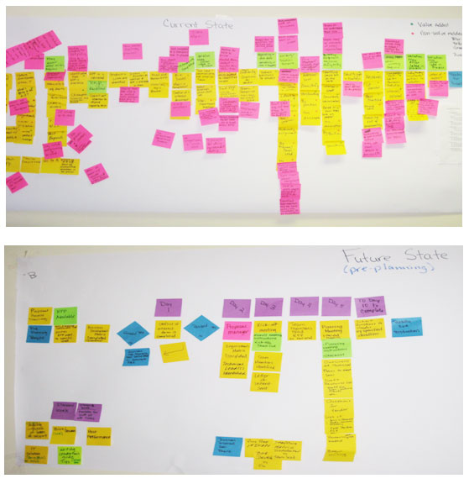
VSM Future State
Construction of a future state map
Notes:
A comparison of a current value stream map v’s a future map demonstrates a more streamlined process with less waste and process steps.

Slide 24
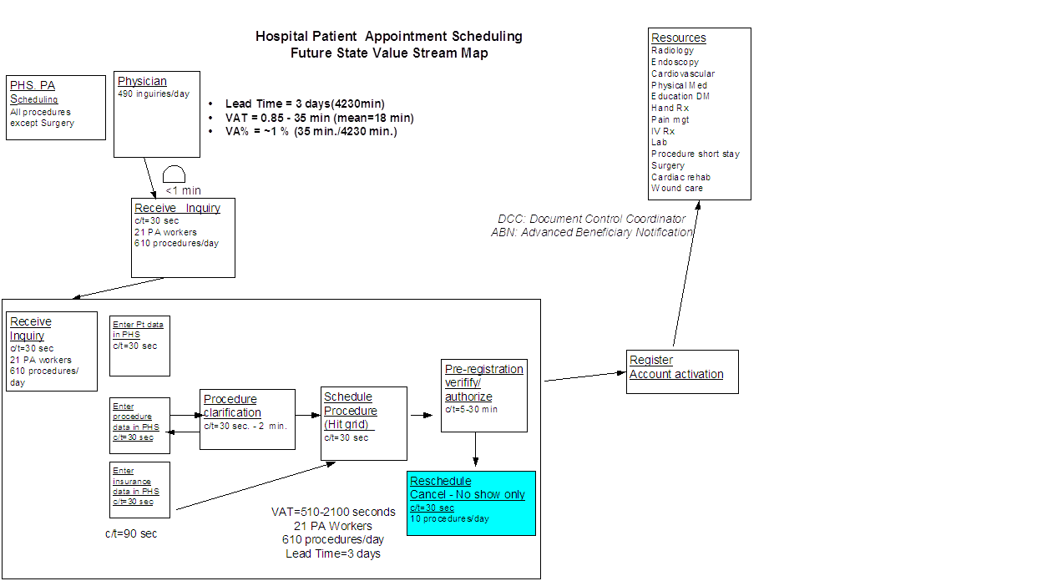
VSM Future State
Example future state
Notes:
An example of a future VSM for a hospital patient appointment schedule is shown.
There is a centralised process with definite cycle times set up to issue appointment. The lead time is no more than 3 days.

